Slide 1
Emergency Warning System
Important messages sent directly to mobile telephones
Notes:
Suggested script The note fields contain a suggested script. This can be used if required, but should be adapted to the year level.
Today we have received an important message from the Police and Civil Defence. We are going to talk about the Emergency Warning System – a system that can send notifications to almost all mobile telephones in Norway within a few seconds if a serious incident happens.

Slide 2
Notes:
Norway is one of the safest countries in the world. However, accidents and other incidents can occur, and the authorities – for example the Police, need to be able to notify us quickly.
As in this example: It appears that there has been an accident at a factory, and hazardous smoke is drifting towards a town.
Or possibly: What do you think has happened here? In this case, it is important that those who live in the town are informed as quickly as possible.

Slide 3
Notes:
If something serious happens, the Police or Civil Defence can send an Emergency Warning by mobile telephone. All newer mobile telephones will receive the warning within a few seconds. The telephone will play a loud sound and vibrate – even if you have it in silent mode. Messages may also be displayed on some tablets and smart watches.
If you put your telephone into flight mode or switch it off completely, you will not receive the warning.

Slide 4
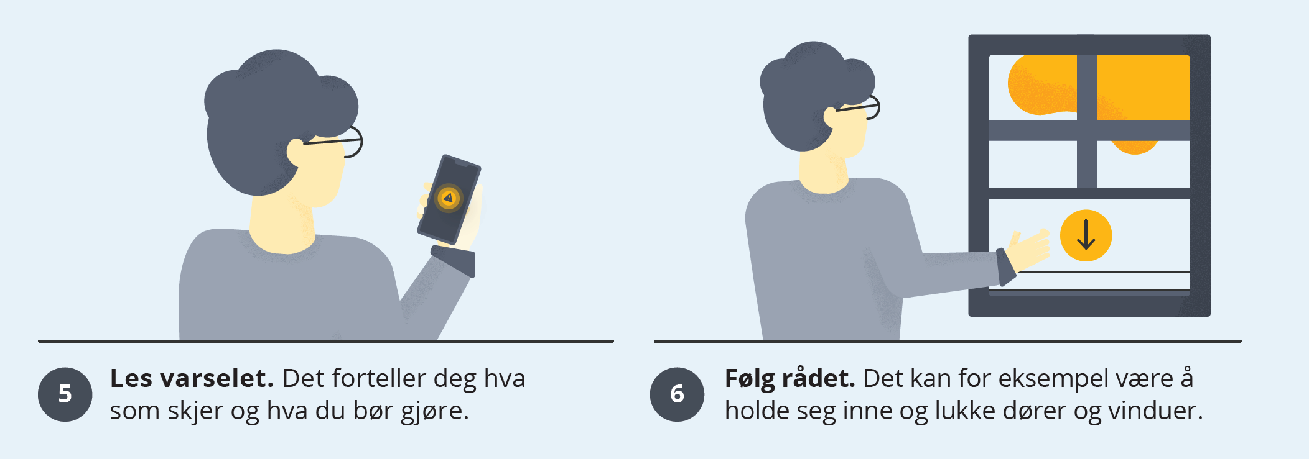
Notes:
If you receive an emergency warning on your mobile, it will state what is happening, and what we should do.
It is important that we read the warning and follow the advice given. In this town, everyone is informed that they must stay indoors and close their doors and windows because of the hazardous smoke.

Slide 5
Test on Wednesday 12 June at 12:00
The following happens when you receive an Emergency Warning:
Your telephone will vibrate and play a loud, siren-like sound
Your screen will display a short text message informing you of what is happening and what you should do
The text does not mean there is any danger – we are only checking that the system functions properly
If you do not want to receive the test, you must switch off your telephone before 12 June at 12:00
Notes:
On Wednesday 12 June, the system will be tested. A test message will be sent out. We do not need to do anything.
It may be a little frightening when so many mobile telephones begin to play the sound at the same time – but there is no danger.
It is a bit like checking that a smoke detector is working. It makes a loud noise, but it is good to know that the system functions properly.

